Slide 1

ADRIFT in the California Current
Passive Acoustic Monitoring in the California Current using Drifting Recorders
Shannon Rankin
Anne Simonis, Taiki Sakai, Cory Hom-Weaver, Kaitlin Palmer & Kourtney Burger
Southwest Acoustic Ecology Lab
Southwest Fisheries Science Center, NOAA Fisheries

Slide 2
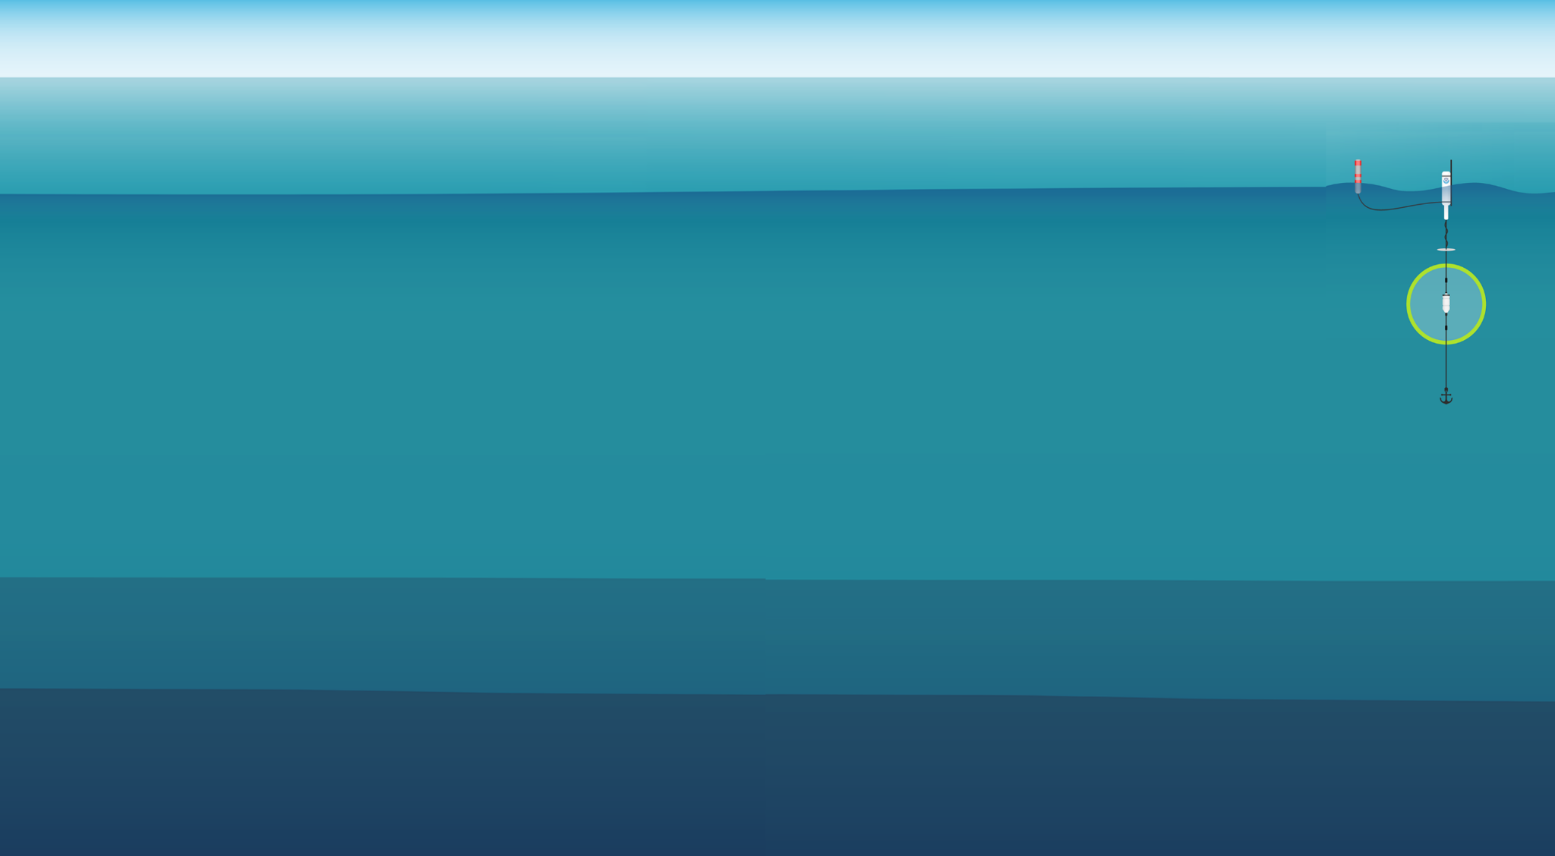
Outline
What is ADRIFT? Why?
Summary of Results
Highlights
Recommendations

Slide 3
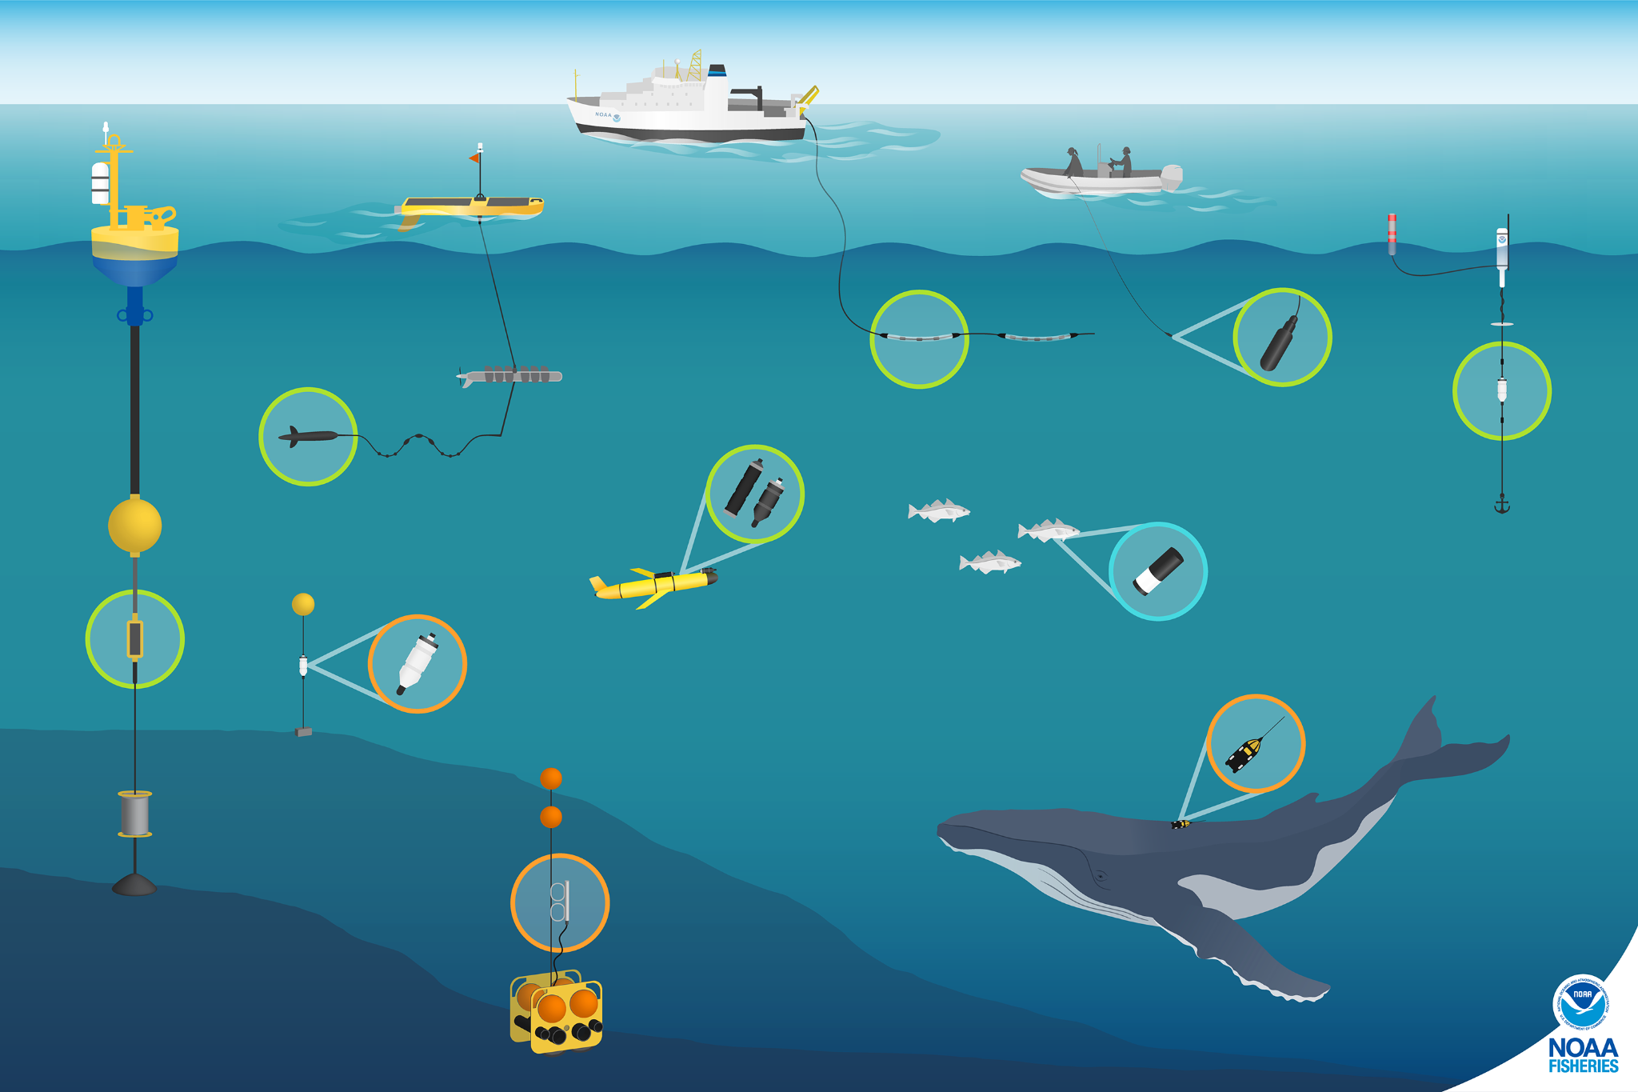
PAM
Passive Acoustic
Monitoring
Towed Array
Drifting Recorder
Seafloor Hydrophone

Slide 4

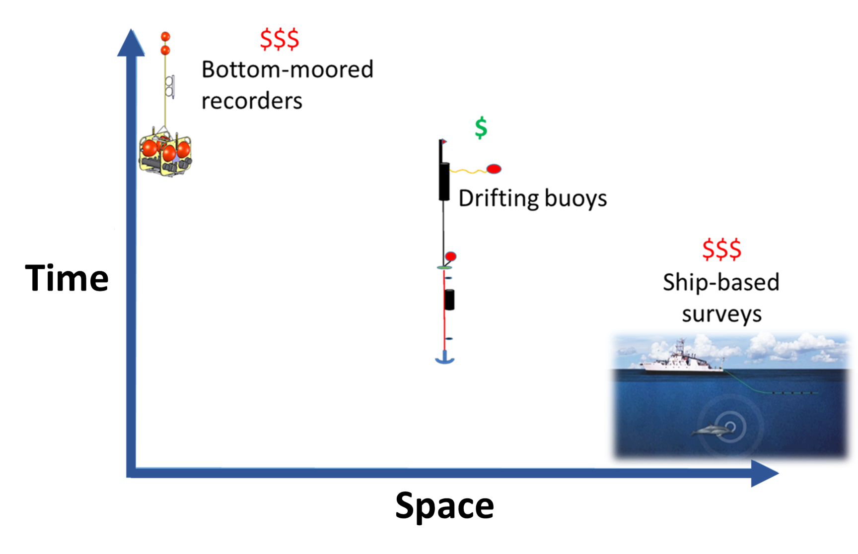
Why ADRIFT?

Slide 5
Why ADRIFT?
Drifting Recorders:
Data collection in deep, offshore waters
Inexpensive instruments
Allows for greater potential sampling effort
Moderate temporal/geographic resolution
Easy deployment/retrieval
Can be deployed from Vessels of Opportunity
Mid-Depth (listen near animals!)

Slide 6
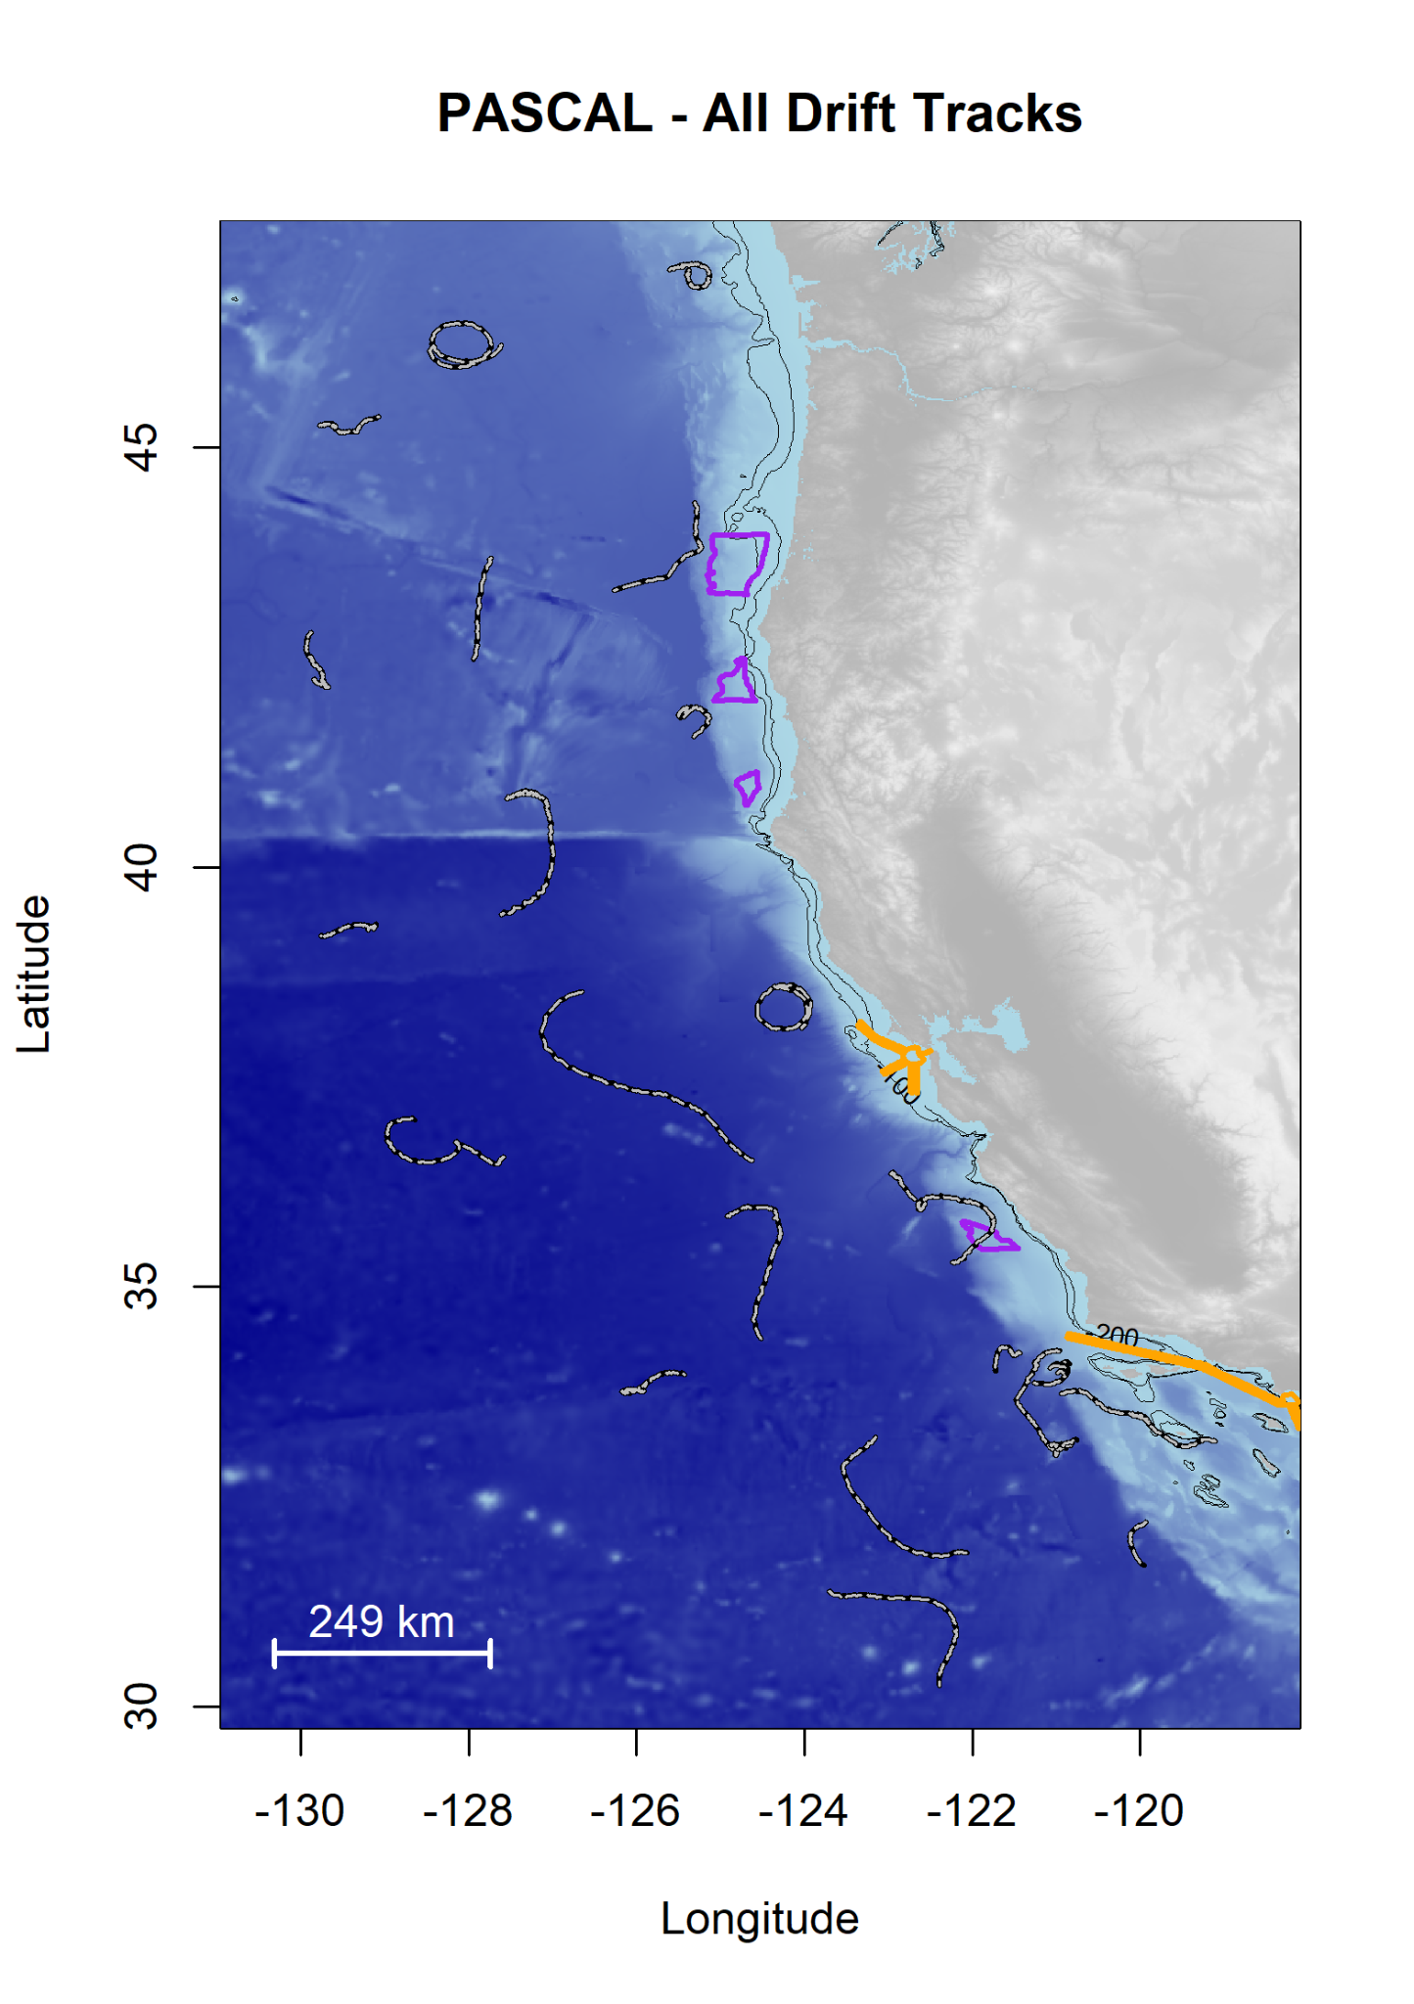
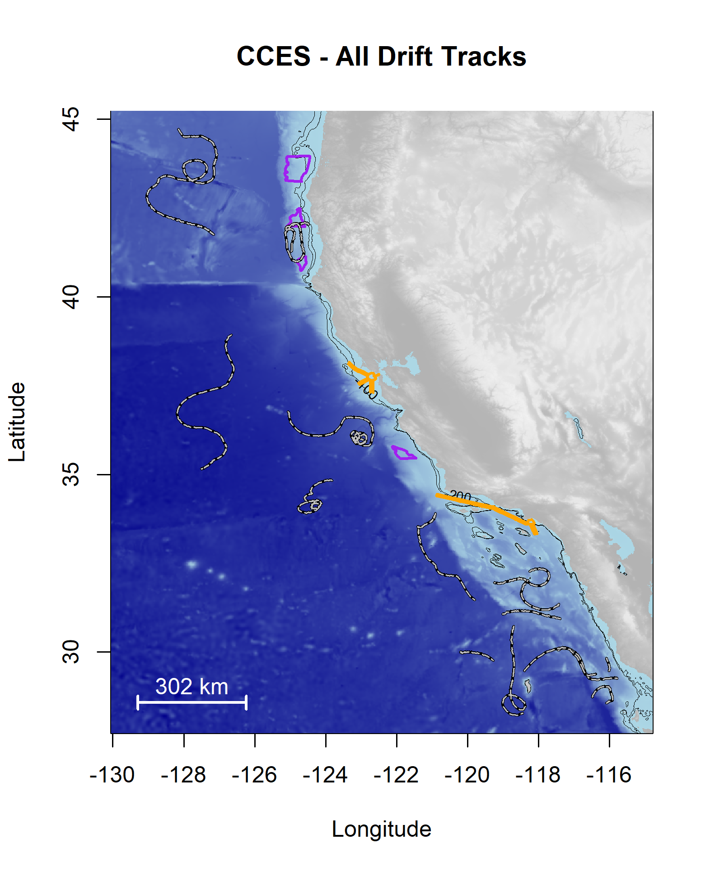
What is ADRIFT?
2016
2018

Slide 7

ADRIFT in the California Current:
Spatial and Temporal Distribution of Cetaceans in the California Current Ecosystem Using Drifting Archival Passive Acoustic Monitoring
Primary objective: collect temporally and spatially representative acoustic data of vocalizing marine mammals and ocean noise using drifting acoustic recording buoys in the California Current, with specific deployments in and around BOEM’s renewable energy Call Areas.
The specific goals:
(1) deploy drifting acoustic recorders in/around BOEM’s renewable energy Call Areas,
(2) archive recording data for analysis,
(3) analyze archived data for population assessment of dolphins & whales, and
(4) analyze archived data for soundscape assessment.
Period of Performance:
June 2020 - June 2023
Extended to August 2024

Slide 8
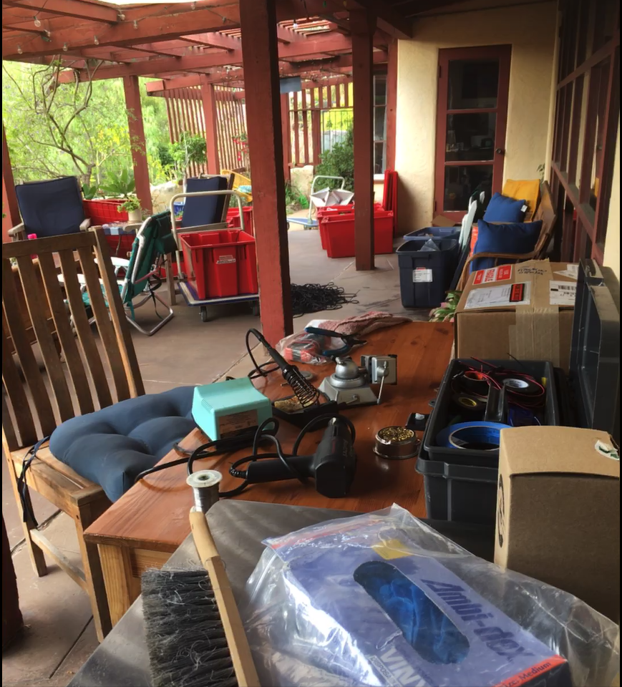
Covid
Fieldwork:
Cancelled (mid-2021)
Fieldwork Difficult (mid-2022), intense paperwork
Continuing complications through 2023 (staffing, NOAA vessels unreliable, lowered capacity for collaboration)
Archived Data:
NO access (thru late 2021),
Remote access to server took >18 months
Difficult access (thru mid-2022)
Build Equipment:
Supply Chain Issues
No access to lab (build at home, alone!)
Excessive Red Tape for E.V.E.R.Y.T.H.I.N.G
Long delays/Difficult in hiring
Partnerships: high interest, but no capacity

Slide 9
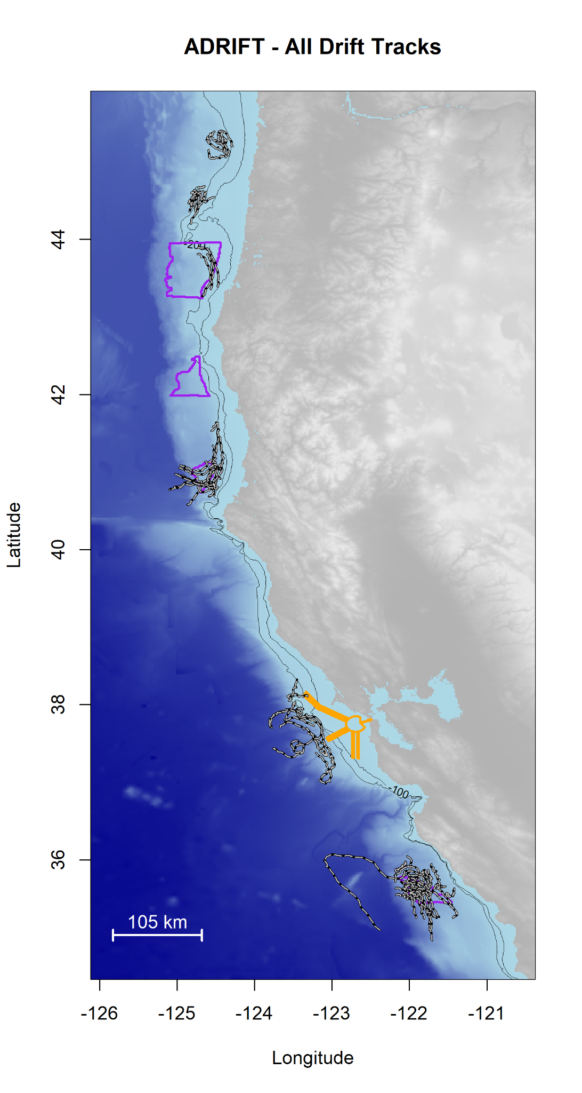
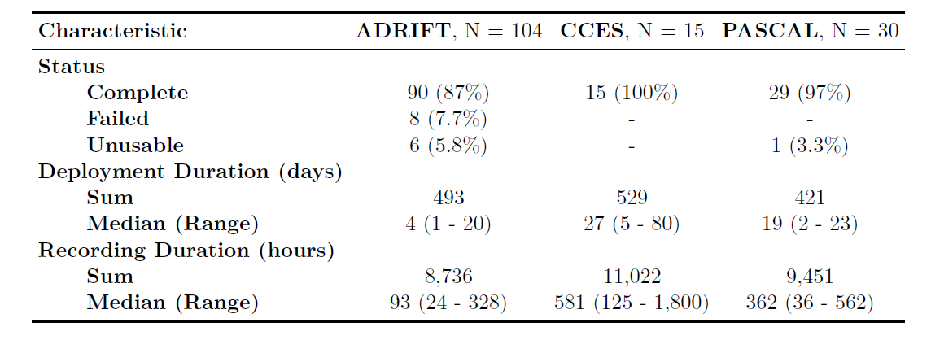
What did we Learn?
(4) Oregon
1a) Humboldt (2020/21 - 2023)
1b) San Francisco (2021 - 2023)
2) Morro Bay (2021/22 - 2023)
3) Oregon (2022/23 - 2023)
(1) Humboldt
(2) San Francisco
(3) Morro
Bay

Slide 10
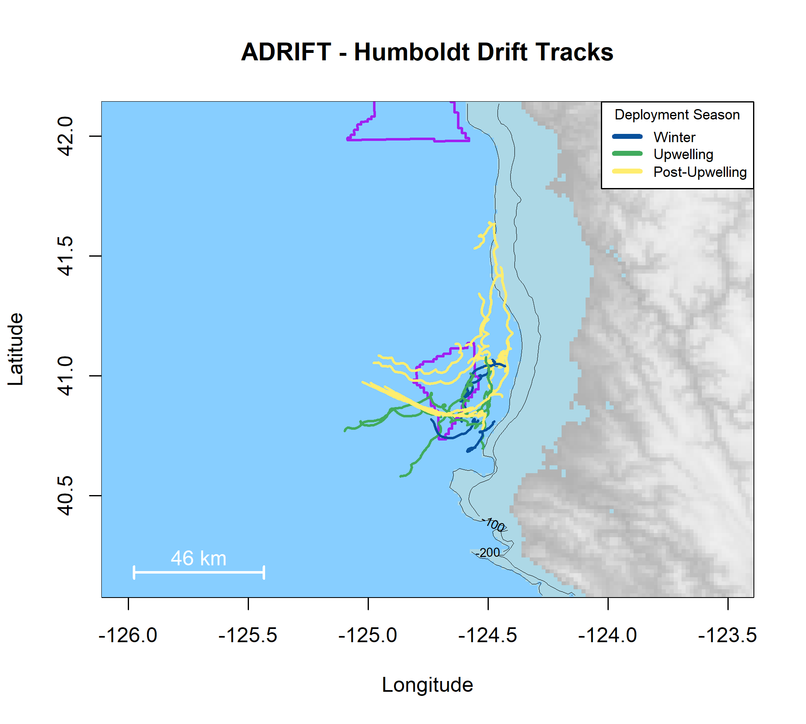

Humboldt
Partner: Cal Poly Humboldt
Clusters of 2-4 buoys
33 Deployments (3 losses, 2 bad data)
Limitations
Difficult Environment (Currents, Cape Mendocino, Lost Coast, Offshore Bar, bad weather)
Resource Competition on good weather days
Strengths:
Great partner potential

Slide 11
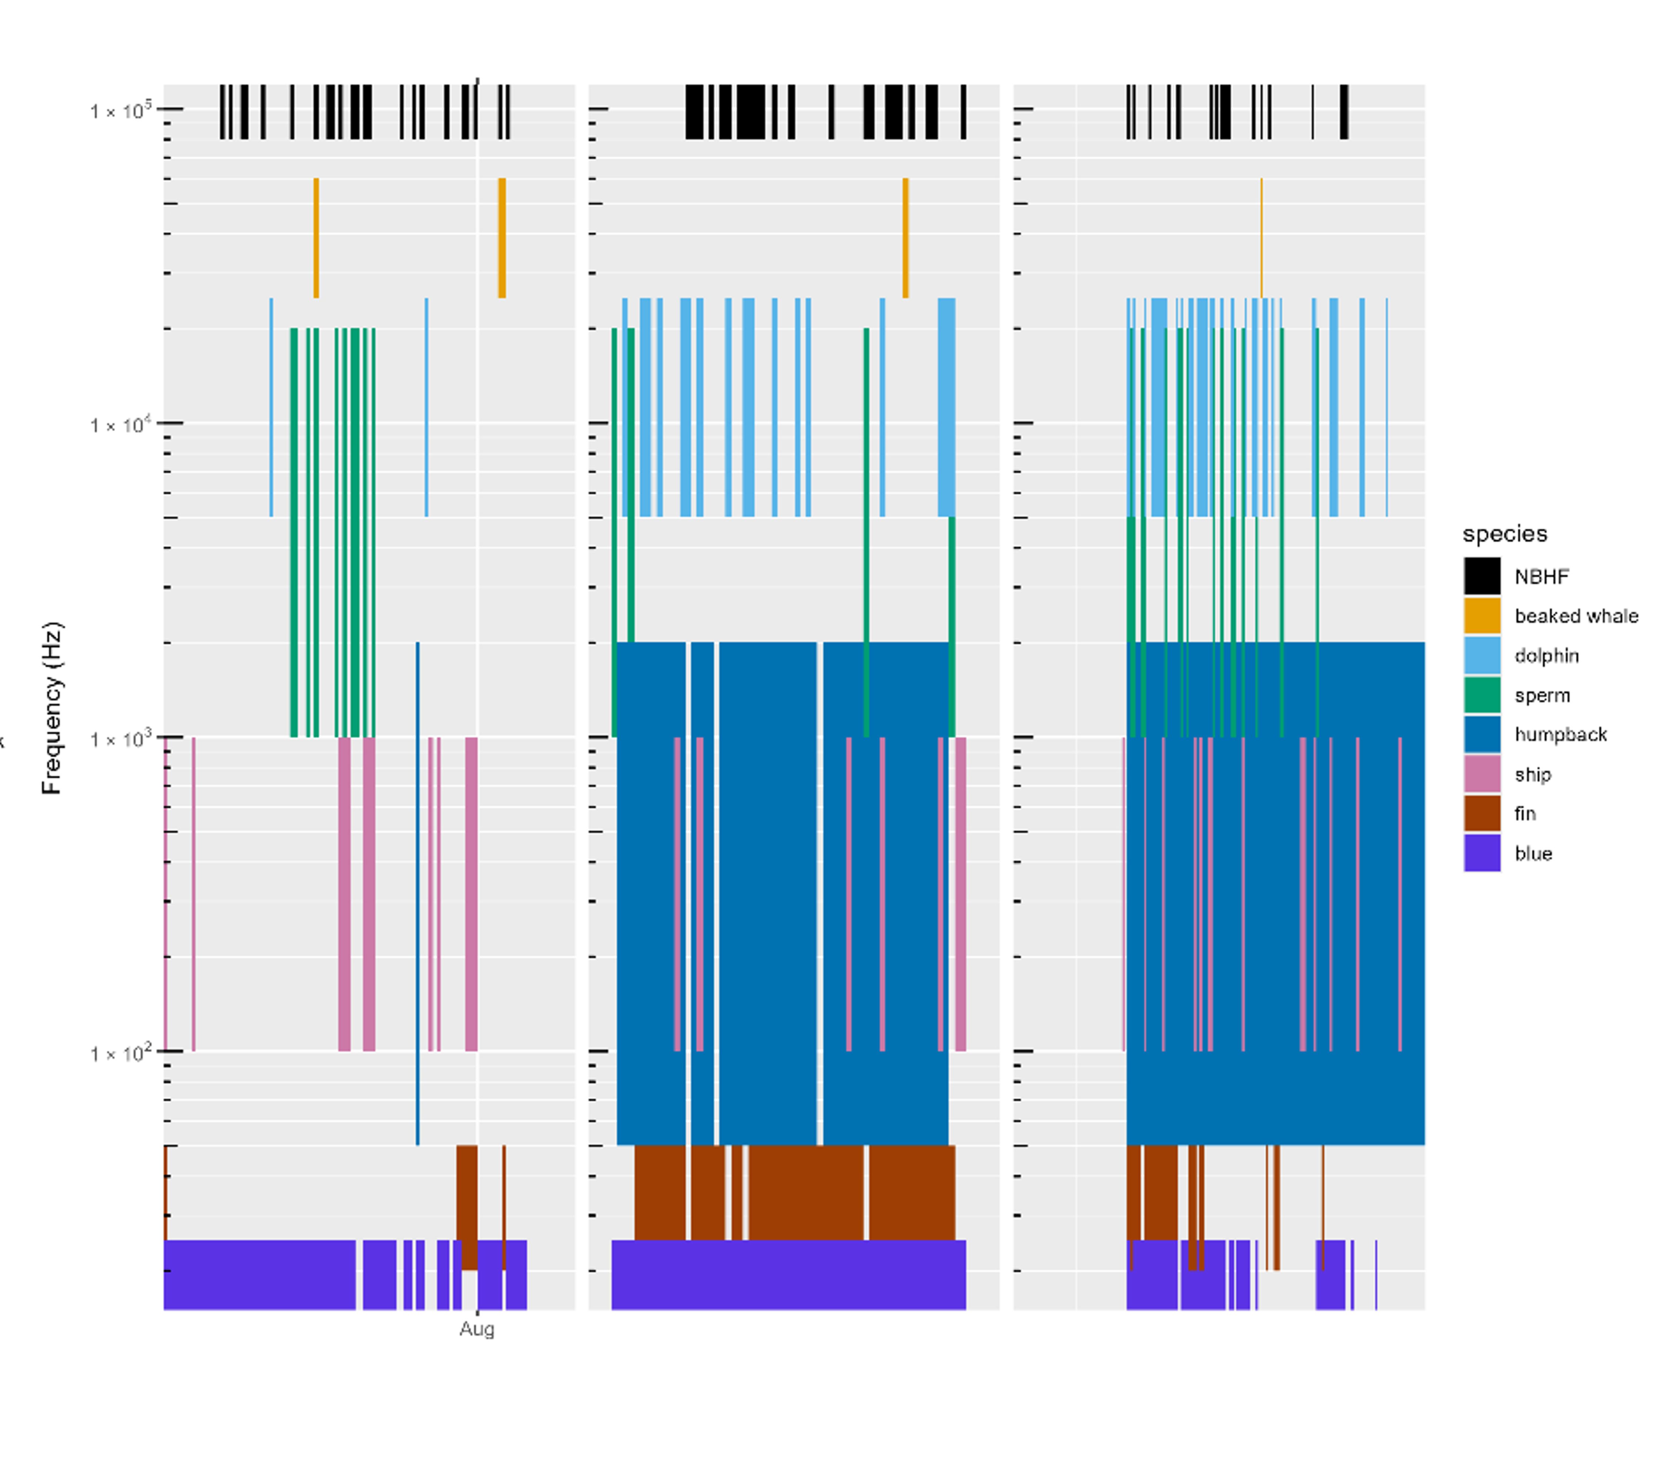
Humboldt
Species:
NBHF
Beaked whales*
Dolphins
Sperm whales
Gray whales*
Humpback whales
Ship Noise
Fin Whales
Blue Whales
*uncommon

Slide 12
Humboldt
Species:
NBHF
Beaked whales*
Dolphins
Sperm whales
Gray whales*
Humpback whales
Ship Noise
Fin Whales
Blue Whales
*uncommon

Slide 13
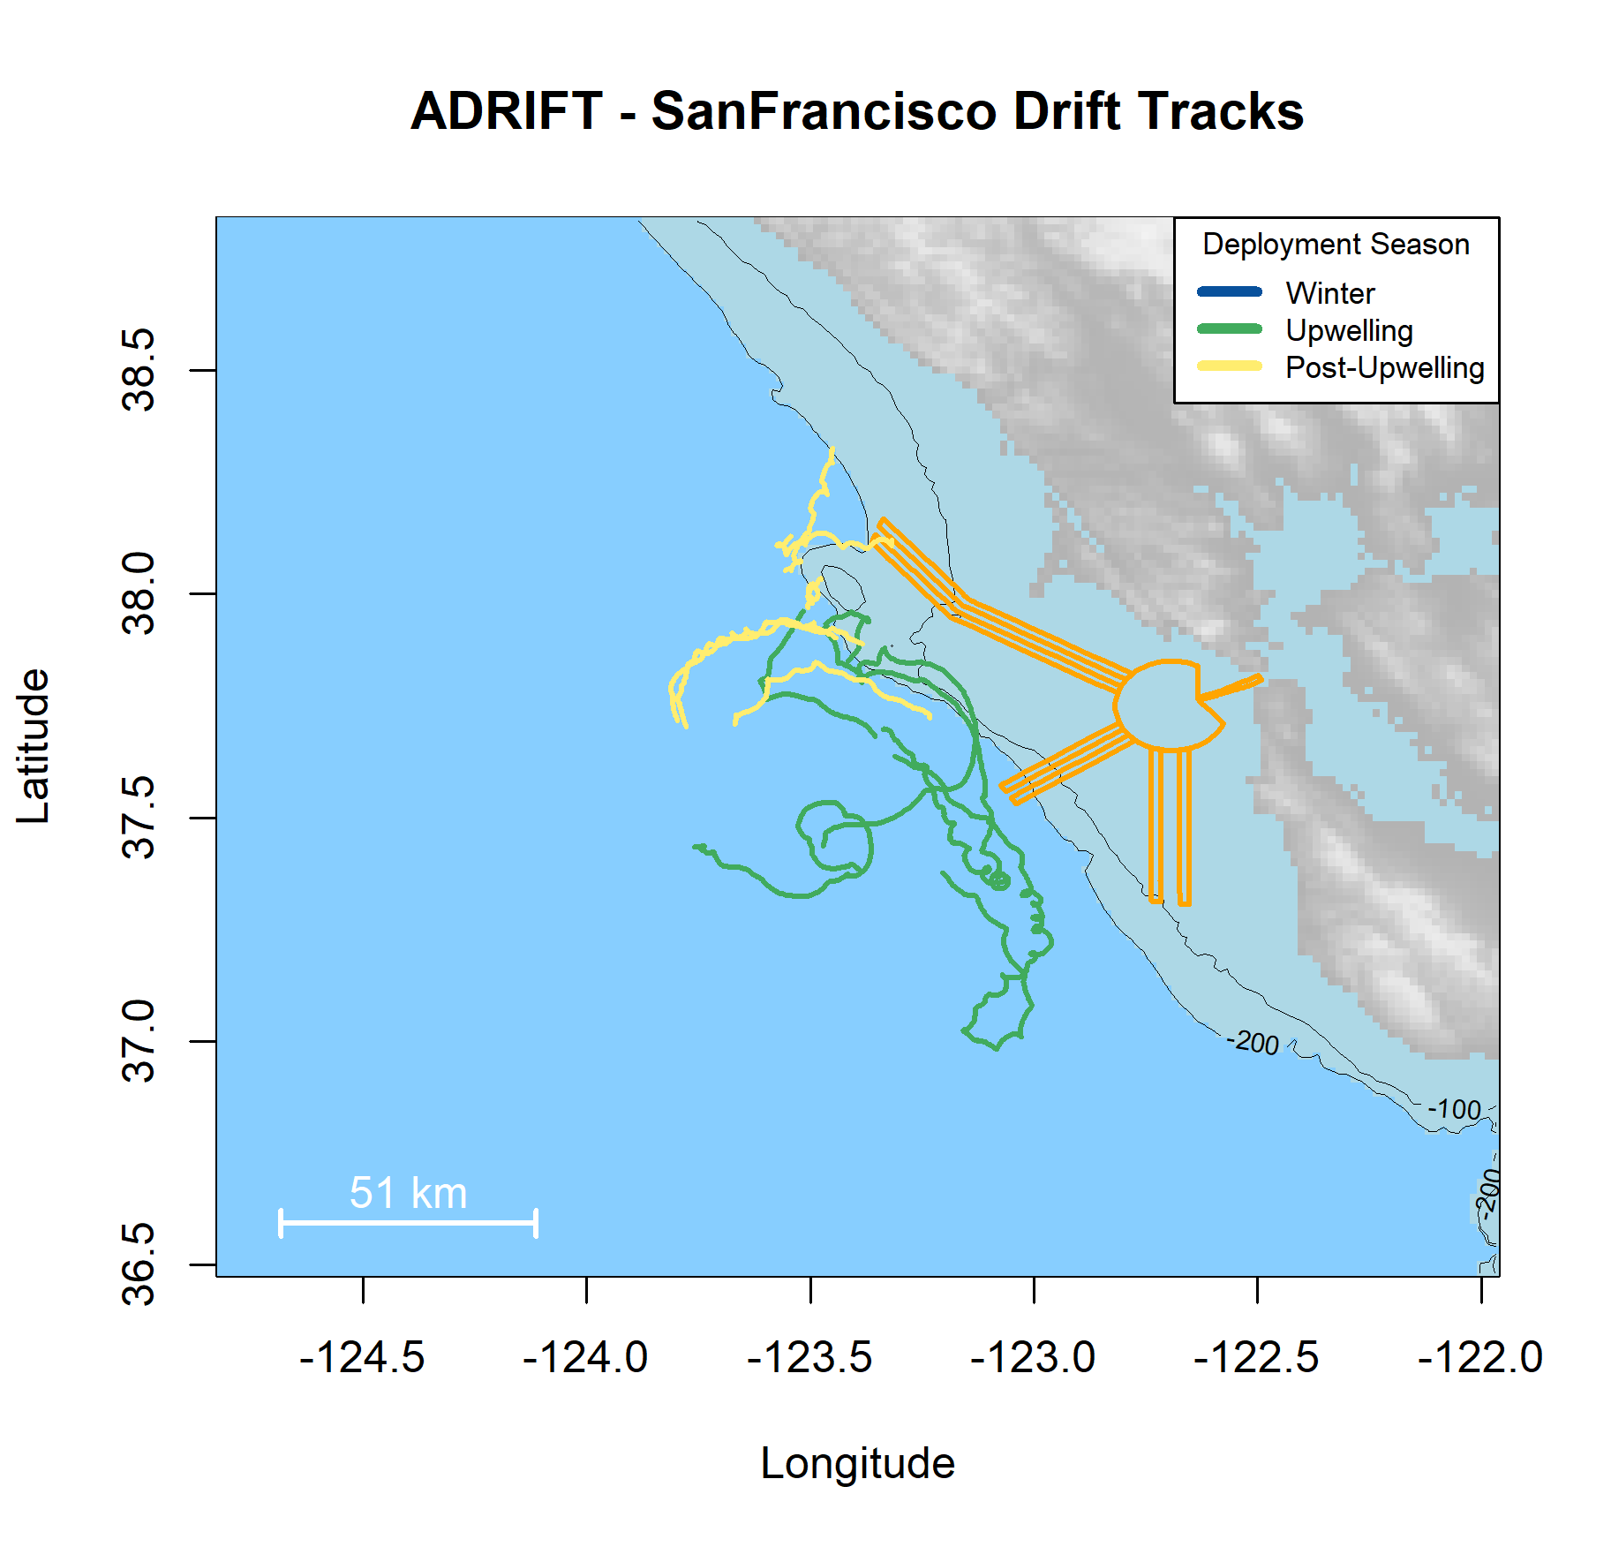


San Francisco
Partners:
ACCESS Survey (GFNMS/CBNMS)
San Francisco State University
2 buoys per survey (not clustered)
11 Deployments (3 losses, 3 bad data)
Limitations
Vessel traffic
Seamounts (grounding)
Strengths:
True Partnership, Vessel/Scientists
Potential for additional partners

Slide 14
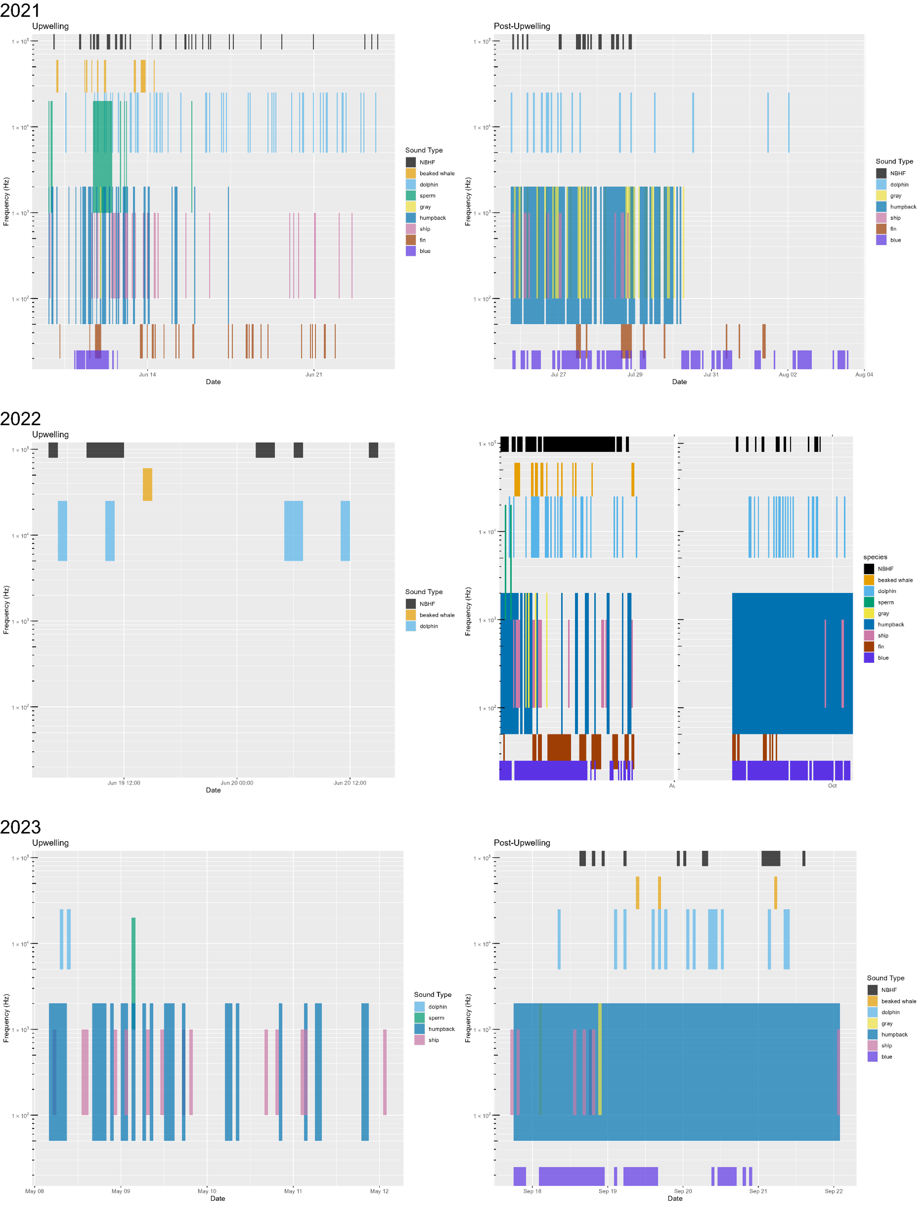
San Francisco
Species:
NBHF
Beaked whales
Dolphins
Sperm whales
Gray whales
Humpback whales
Ship Noise
Fin Whales
Blue Whales

Slide 15
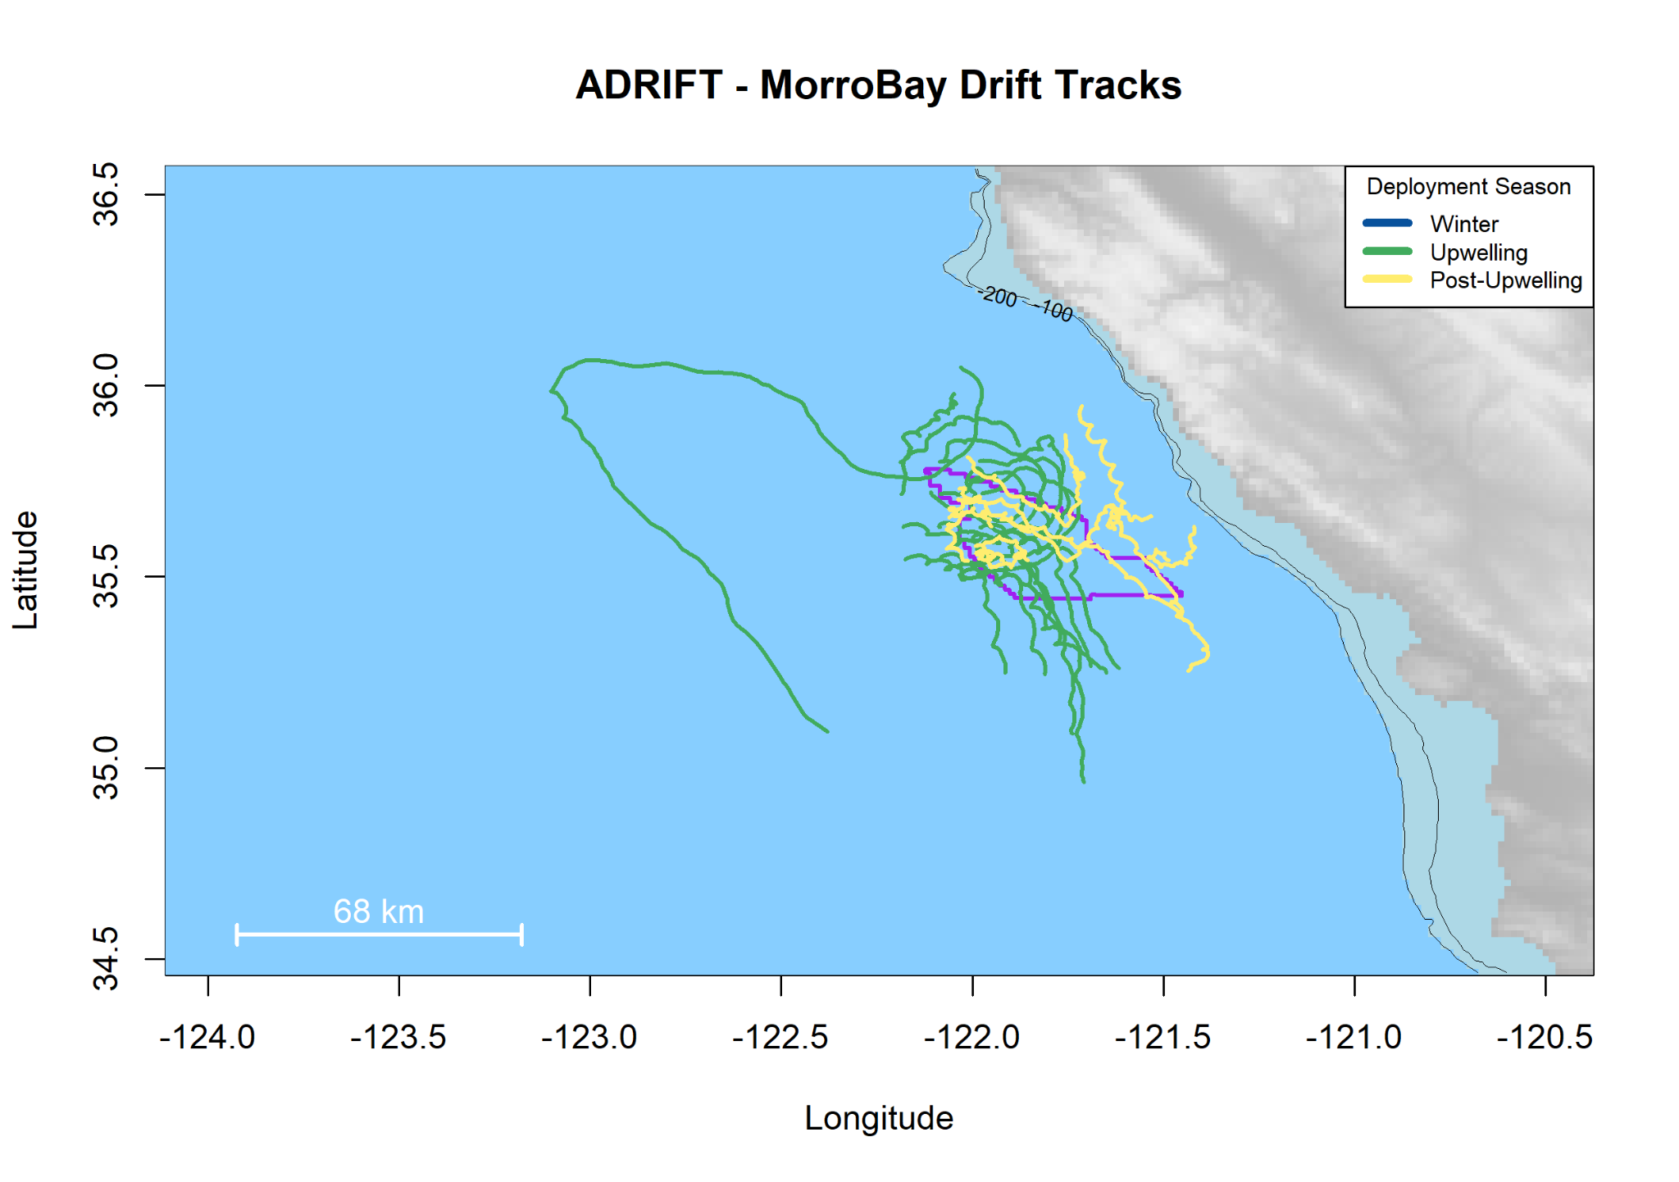




Morro Bay
Central Coast Collaborative
PAM Surveys (Tri-C’s)
Clusters of 8 buoys
32 Deployments (2 losses),
10 opportunistic recordings
Limitations (?)
Strengths:
Strong Partners, Collaborators
Great survey potential

Slide 16
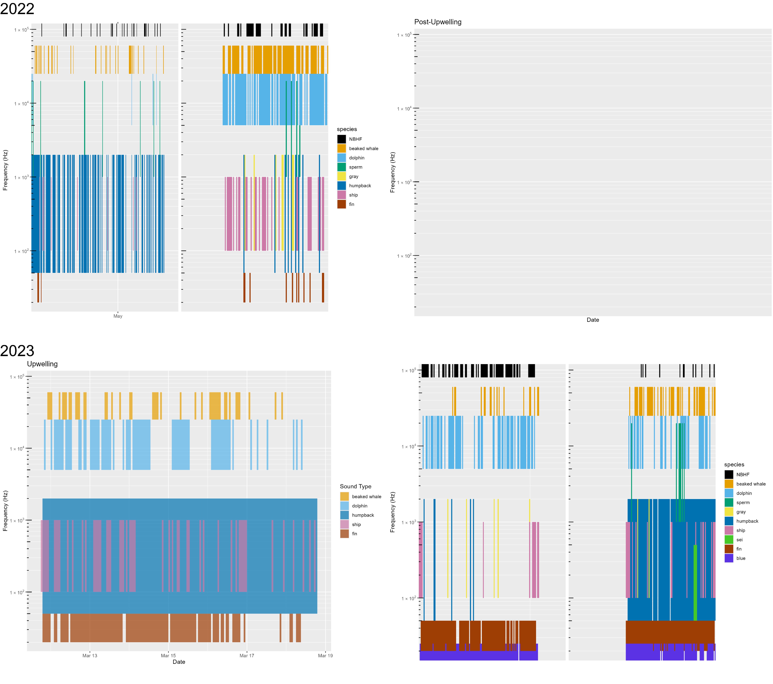
Morro Bay
Species:
NBHF
Beaked whales
Dolphins
Sperm whales
Gray whales
Humpback whales
Ship Noise
Fin Whales
Blue Whales

Slide 17
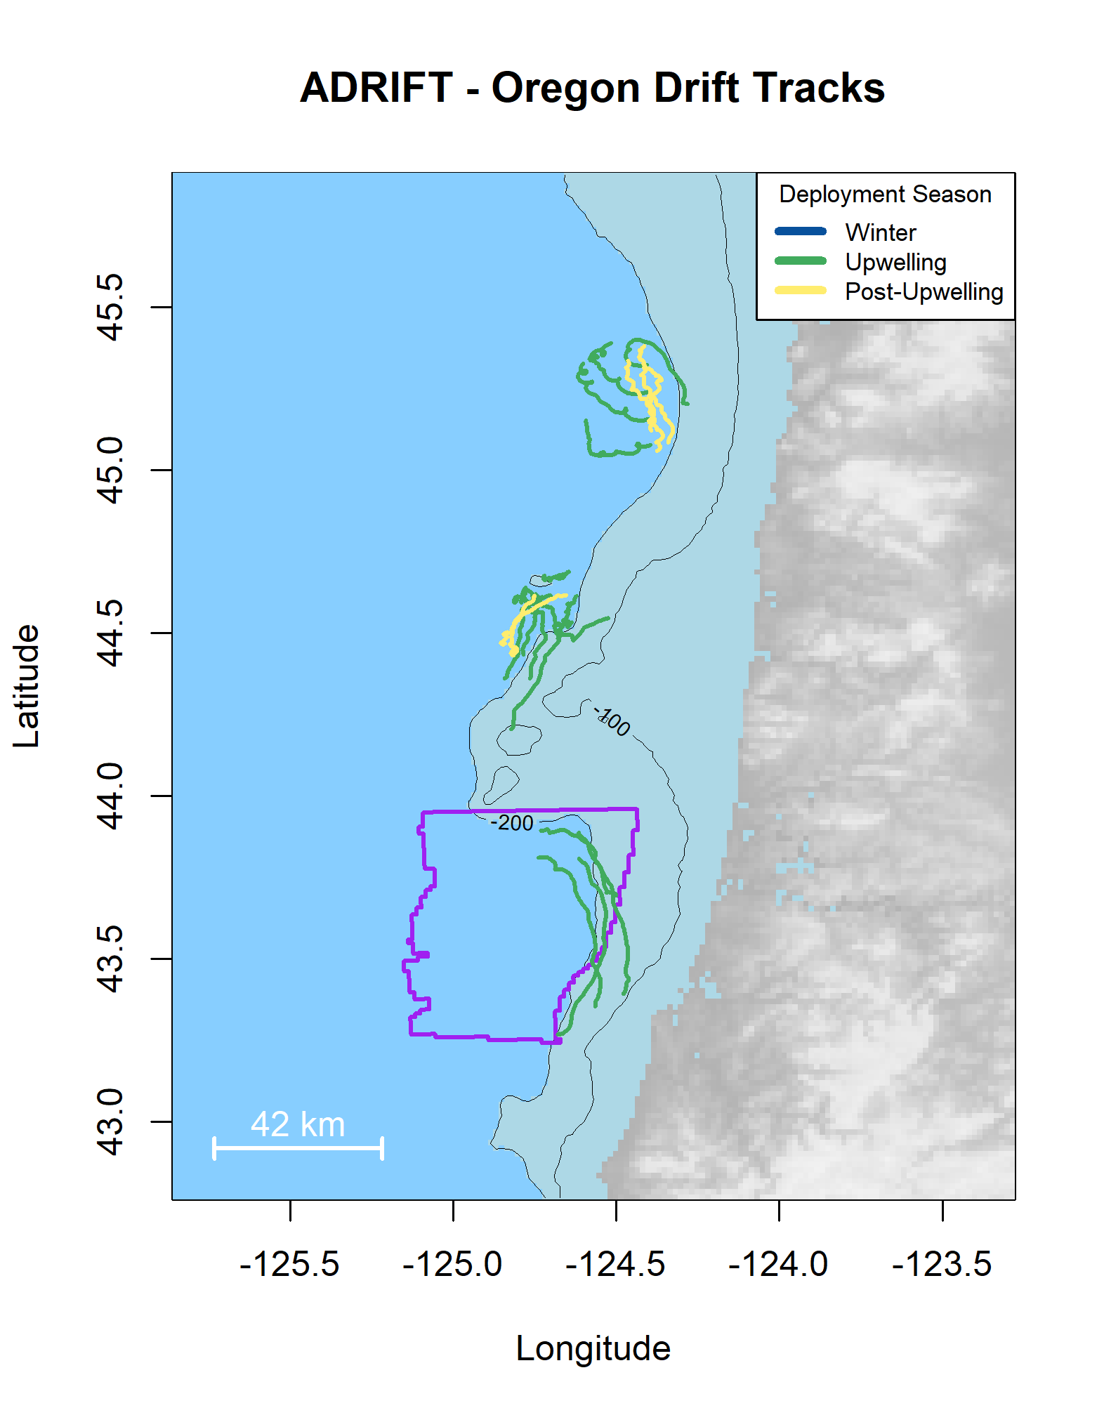

Oregon
Partner Oregon State University
Pilot Study (based on lessons learned)
Clusters of 4 buoys
22 Deployments (0 losses, 1 bad data)
Strengths:
Access to OSU vessels
Limitations
Complications to adding to existing fieldwork

Slide 18
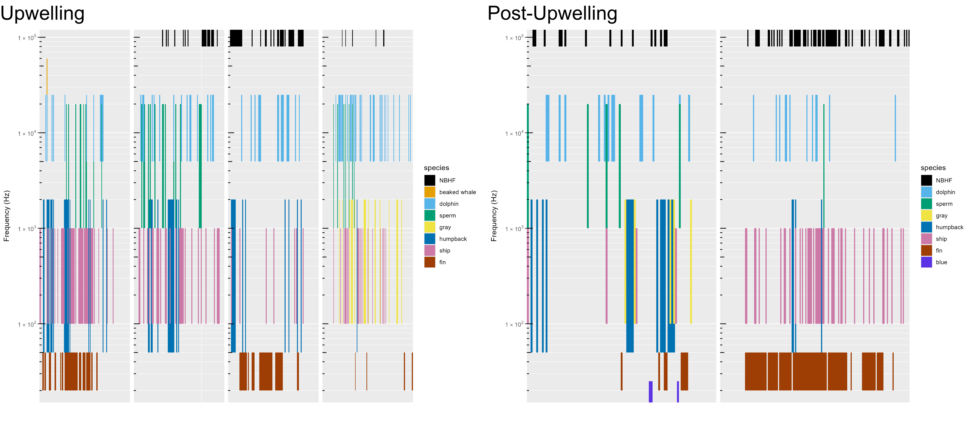
Oregon
Species:
NBHF
Beaked whales*
Dolphins
Sperm whales
Gray whales
Humpback whales
Ship Noise
Fin Whales
Blue Whales*
*uncommon

Slide 19
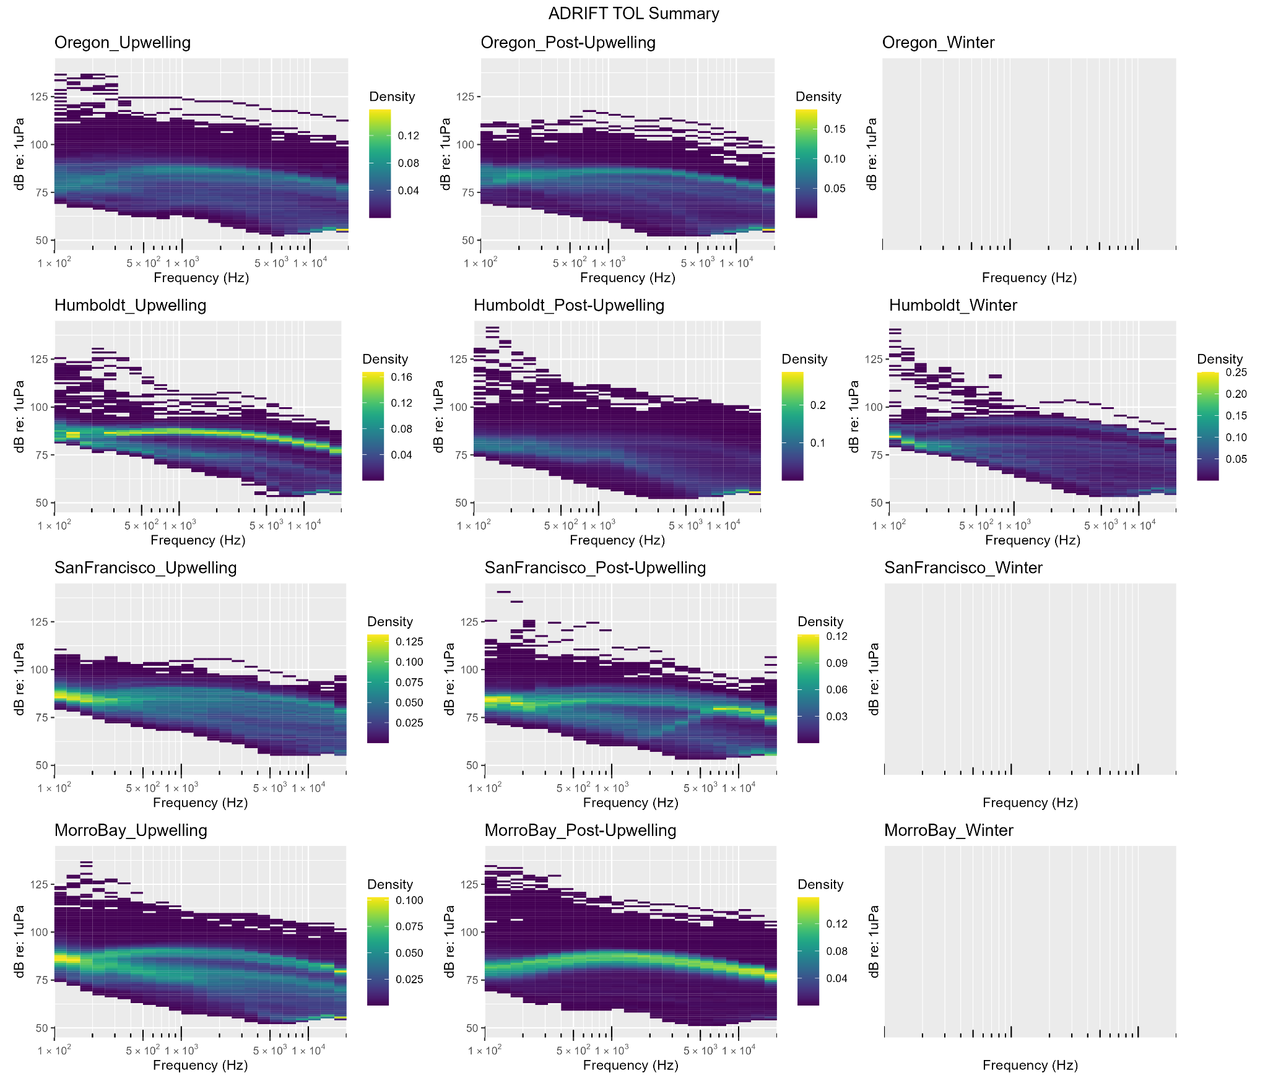
Soundscape

Slide 20
Deliverables
Raw Data + Soundscape + Metadata Archive- submitted to NCEI, in queue
Detection Data- submitted to PACM (NEFSC) for public viewing
Data Products - Github Repository (https://github.com/shannonrankin/ADRIFT_Report)
Final Report + Presentation
Compiled data for data products (deployment data, detection data),
High resolution figures
Code for tables, figures
Ancillary & Supplementary data products
HTML (web) output of results
Education Products
Open Science Products

Slide 21
Research Highlights
Open Source Methods
Beaked whales hiding in dolphin schools
NBHF classification
Clustered deployments to improve localization and define habitat
Clustered deployments to understand geographic variability in soundscape
Sperm whale demographics
Collaborative Surveys
Eavesdropping on the Ocean Data Nugget

Slide 22
Open Source Methods*
Focus on open source methods
Increased time on front end, repeated time savings in the future
Improve transparency, reproducibility
FOSSA (Free and Open Source Software for Acoustics)
PAMpal, PAMmisc
RoboJ (streamline processing of beaked whale data for density estimation)
PAMscapes (NOAA Ocean Acoustics Program)
Methods being adopted by NOAA Fisheries at a national level
ADRIFT Report
https://github.com/shannonrankin/ADRIFT_Report
*Taiki Sakai and entire team!

Slide 23
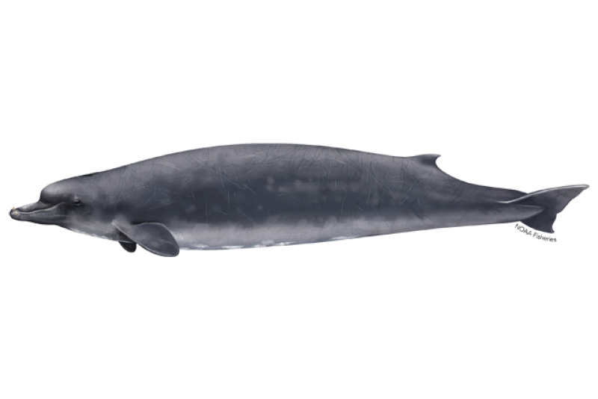
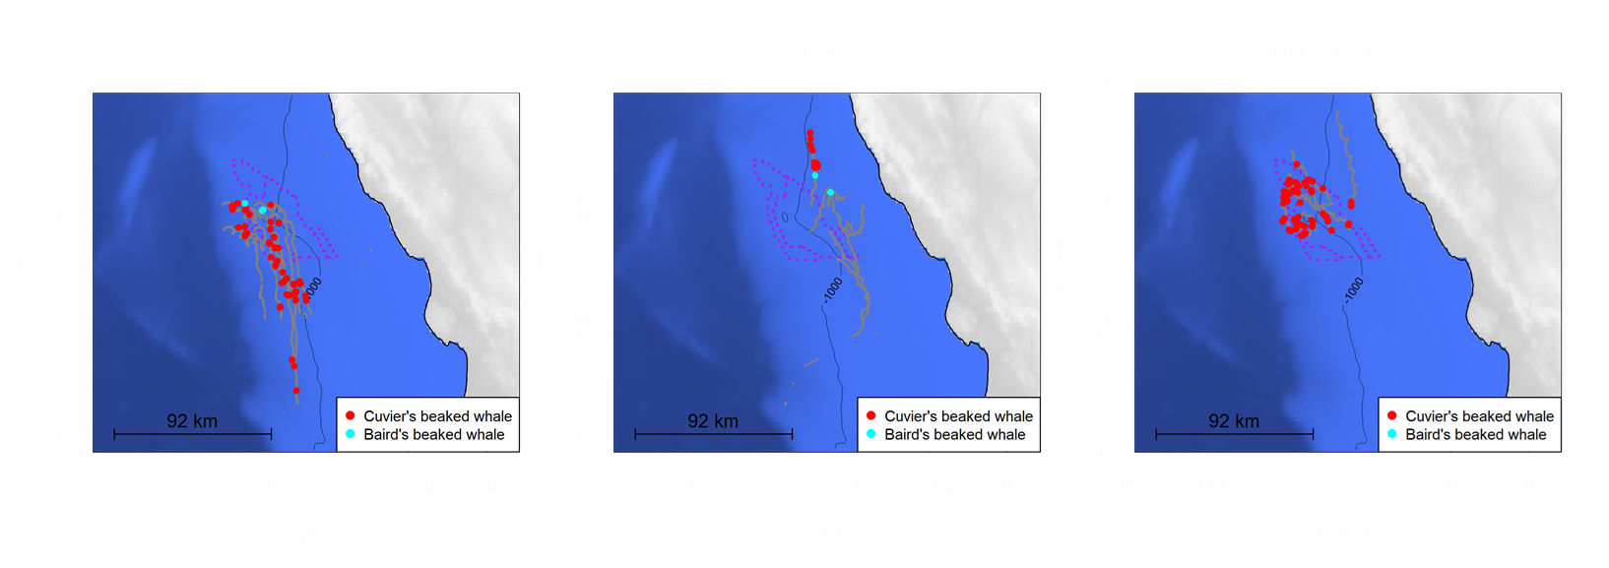
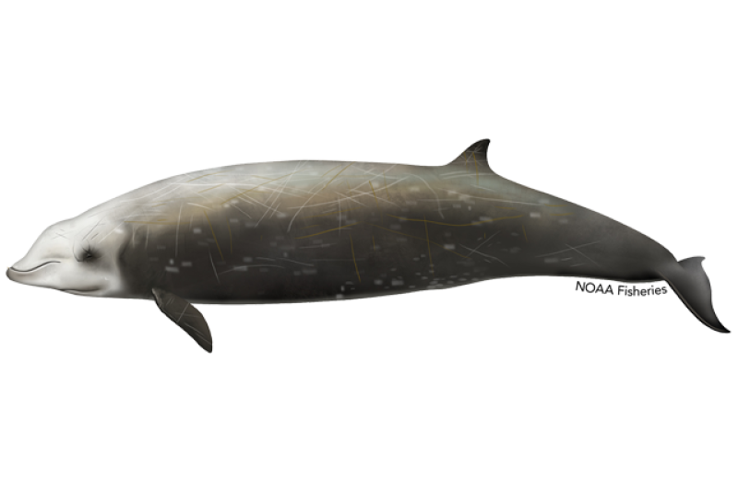
Mixed Beaked Whale & Dolphin Encounters*
Beaked whale echolocation clicks can be ‘hidden’ in dolphin schools
Beaked whales click at depth, Dolphins click near surface
Vertical array at 100m
Beaked whales click below array (>90°), Dolphins click above the array (<90°)
Co-Occurrence of dolphins and beaked whales in Morro Bay
Beaked whales likely missed with alternative platforms when dolphins present
What causes this relationship?
*Anne Simonis, SFSU

Slide 24
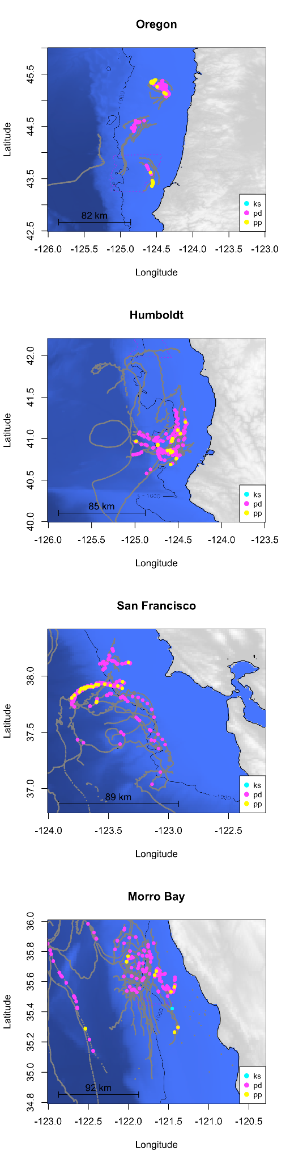
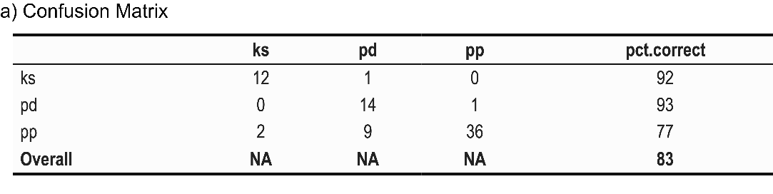
Narrow Band High Frequency Classification*
Comprised 4 species:
Dalls’ porpoise
Harbor porpoise
Kogia simus/breviceps
Preliminary Results: Good, but can be improved
Next Steps: Improve results, apply to existing data to improve our understanding of these species in the California Current
*Jackson Vanfleet-Brown,
Anne Simonis, SFSU

Slide 25
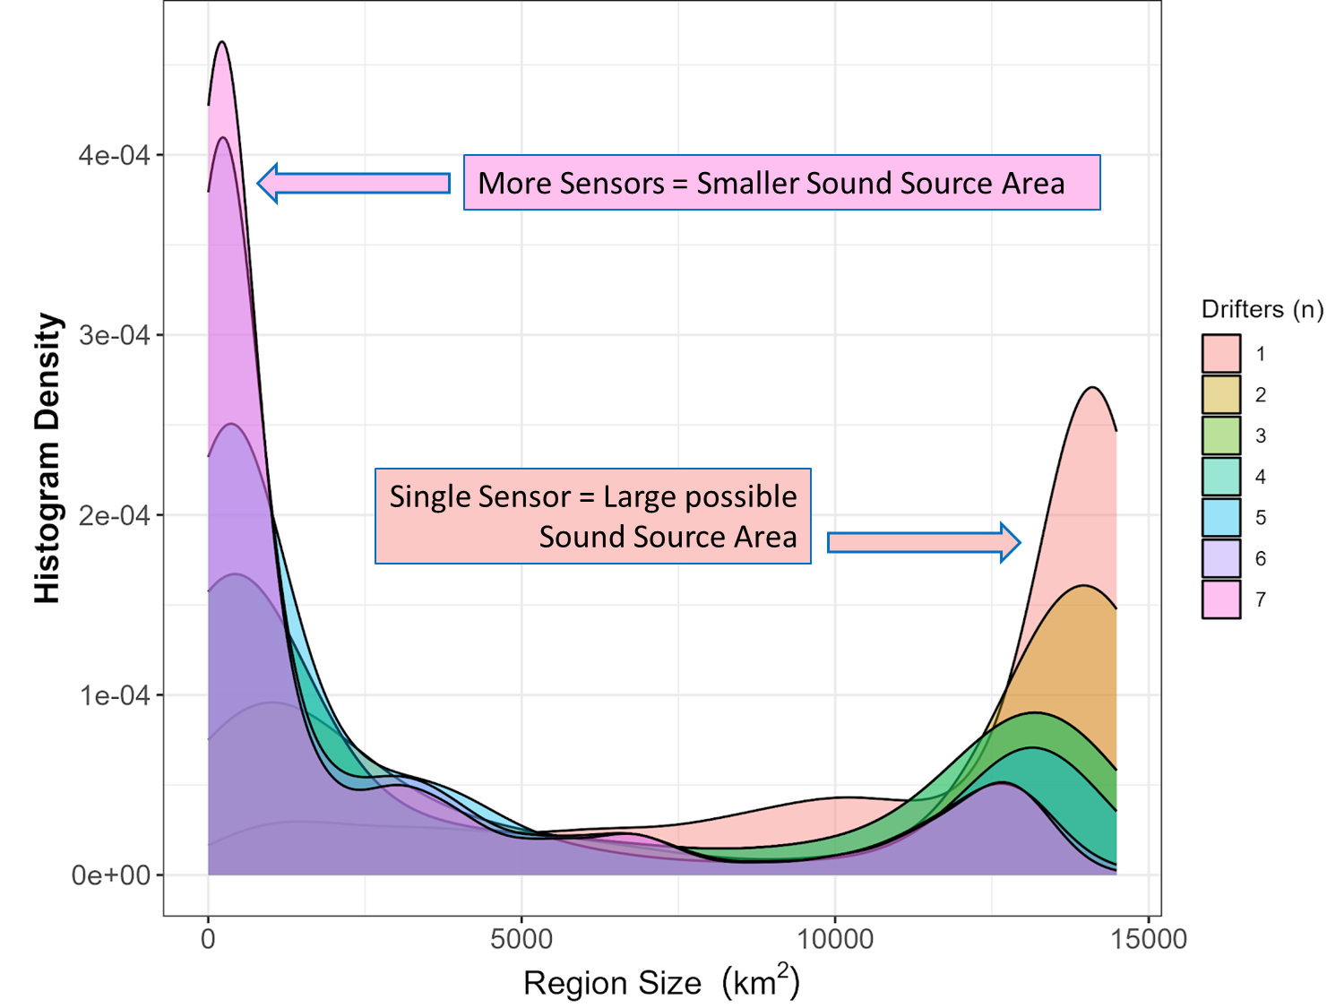
Clustered Deployments: Habitat Variability*
Clustered sensors improve accuracy in locating baleen whales
Improves viability of using data for population assessment
May help refine related environmental predictors
Preliminary exploratory analysis
*Kaitlin Palmer

Slide 26
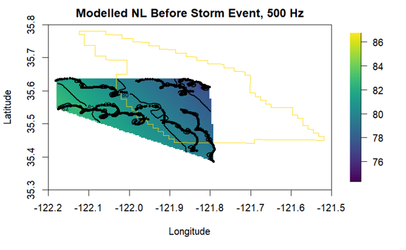
Clustered Deployments: Variability in Soundscape*
Improved understanding of the spatial and temporal variability of contributors to soundscape provided by clustered buoys
*Kaitlin Palmer,
Anne Simonis

Slide 27
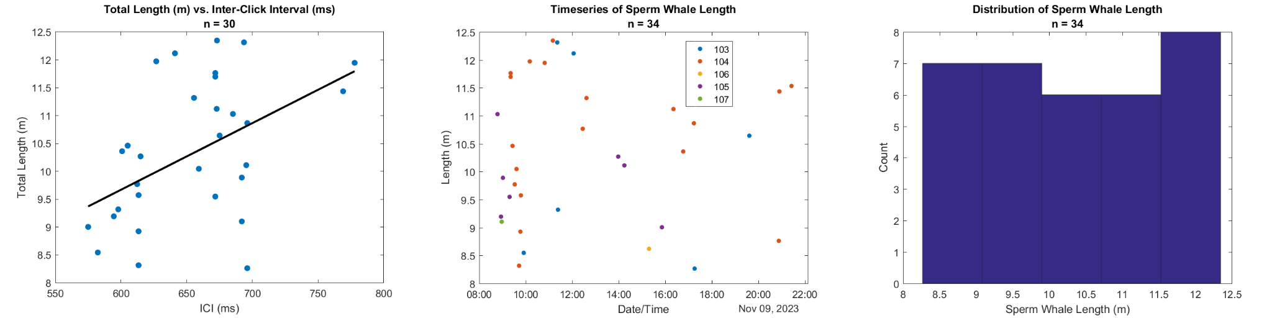
Sperm Whale Demographics*
Pilot study investigated the demographic composition of sperm whales using interclick interval as a proxy for sex/size in acoustic data from a subset of 6 drifting buoys (34 animals).
Mean estimated body length was 10.3 m, suggesting social groups or juvenile males
Different demographic groups have differences in behavior/ecology that may lead to differences in response to anthropogenic threats.
*Natalie Posdaljian, SIO

Slide 28
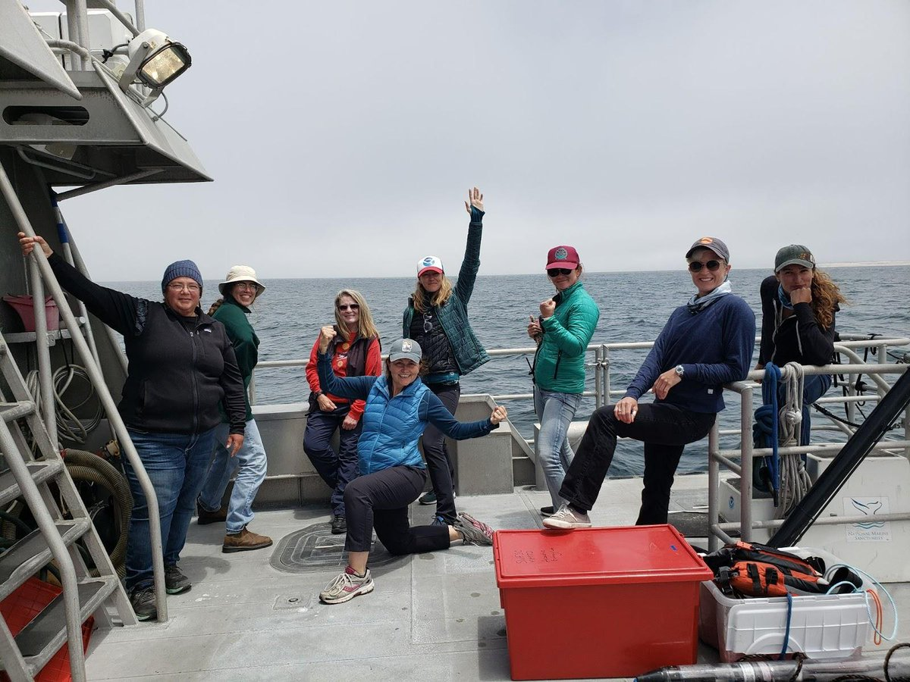
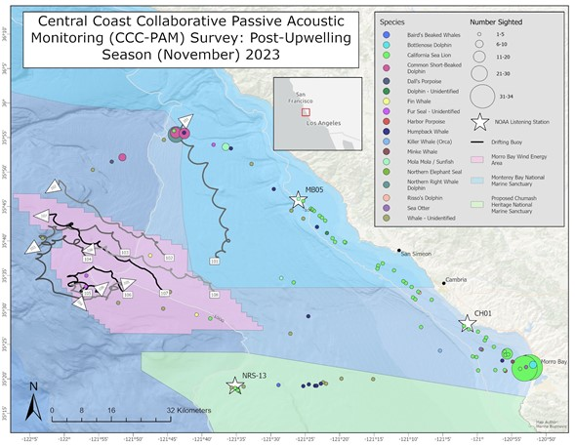
Collaborative Surveys
CCC-PAM Successes
Shared vessel resources
Space for sharing knowledge
Strengthen scientific collaboration
Increased interactions with local community
Daily trips allow stakeholder participation
Shared shoreside lodging strengthen bonds

Slide 29
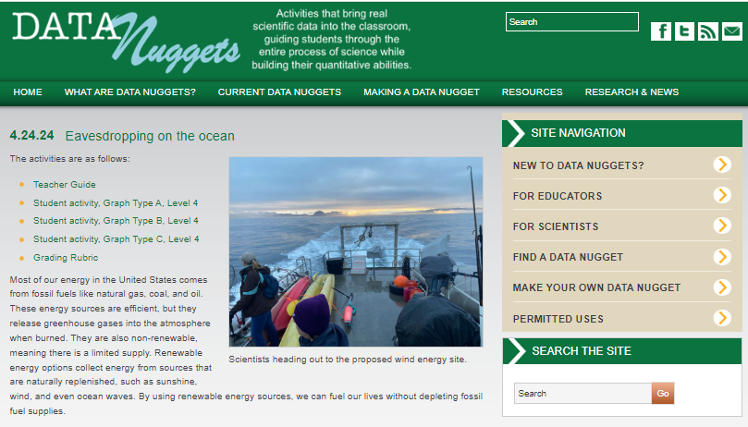
Eavesdropping on the Ocean*
Data Nuggets for Education https://datanuggets.org/2024/04/eavesdropping-on-the-ocean/

Slide 30
Strength of drifting recorders:
Clustered deployments in conjunction with seafloor recorders to provide additional spatial context on marine mammals and soundscape
Additional Recommendations
Beaked whale density estimation
Automate group detection (RoboJ)
Density estimation for Morro Bay (clustered buoys)
Improved ship detectors
Improve understanding of vocal repertoire for sei, bryde’s whales

Slide 31



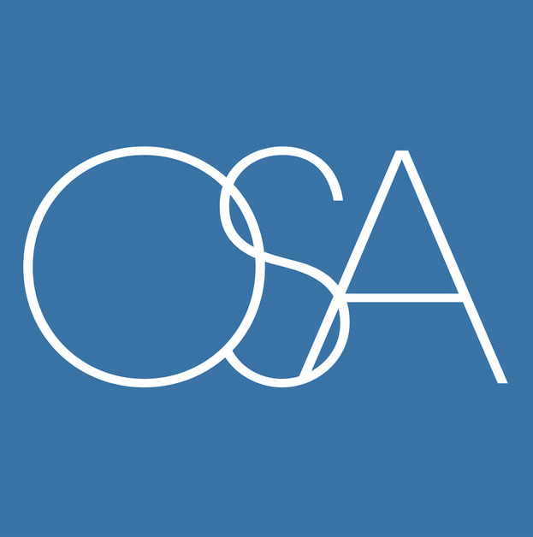

Acknowledgements
Desray Reeb Jeremy Potter John Romero Erin Boydston Ingrid Biedron
Jack Barkowski Doug Gillespie Lanora Vasquez Megan McKenna
Eric Bjorkstedt Lindsey Peavey Jacob Partida Jean de Marignac
Angela Szesciorka Anastasia Kunz Marina Bozinovic Craig Hayslip
Kate Stafford Jackson VanFleet-Brown Jeff Jacobson
Blair Winnacott John Calambokidis Jeff Moore Dick Ogg
Alexandra Fiske Alison Stimpert Robin LeRoux
Maya Phillipp Jan Roletto Leila Hatch Tina Chen
Elizabeth Ferguson Dani Lipski Jay Barlow
Erin Jaszczak Cassie Erickson Marc Schmidt Jason Gedamke

Slide 32
Discussion

Slide 33
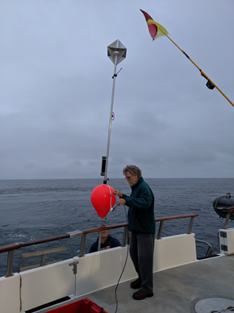
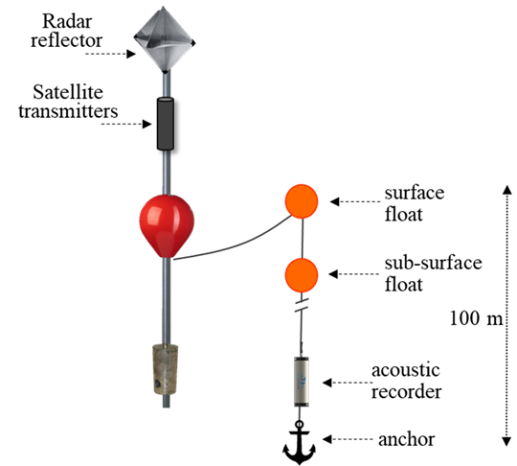
What is ADRIFT?
“DASBRs” Drifting Acoustic Spar Buoy Recorders

